Slide 1

Basic Streaming Pipelines
Joseph Paulo L Mantuano

Slide 2
About Me
Jp has more than ten years of work experience with Software Development building Cloud Ready Applications. Having a background in Banking, Financial, and e-Commerce applications he now found his passion not limited to Full-text search applications, web crawlers and continues to learn making applications that work with moving data.
Linkedin: https://www.linkedin.com/in/jpmantuano/
MeetUp: https://www.meetup.com/Philippines-Elastic-Fantastics/

Slide 3
Two ways of building Kafka Consumers and Data Pipelines Using Apache Nifi

Slide 4

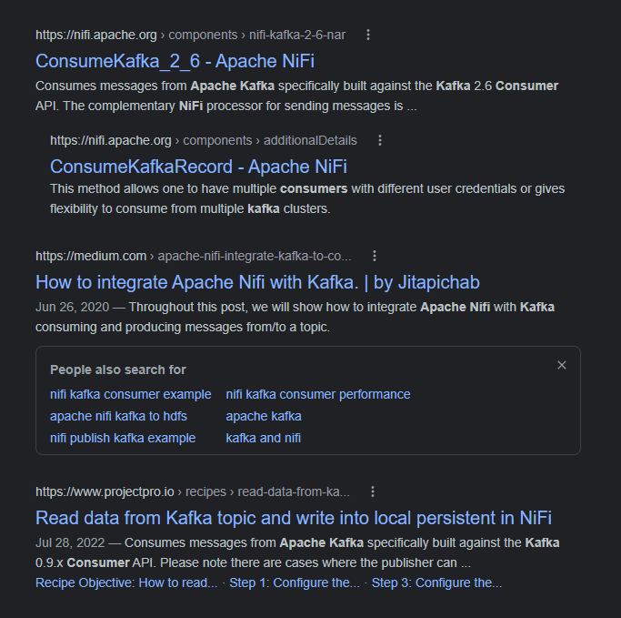

Slide 5
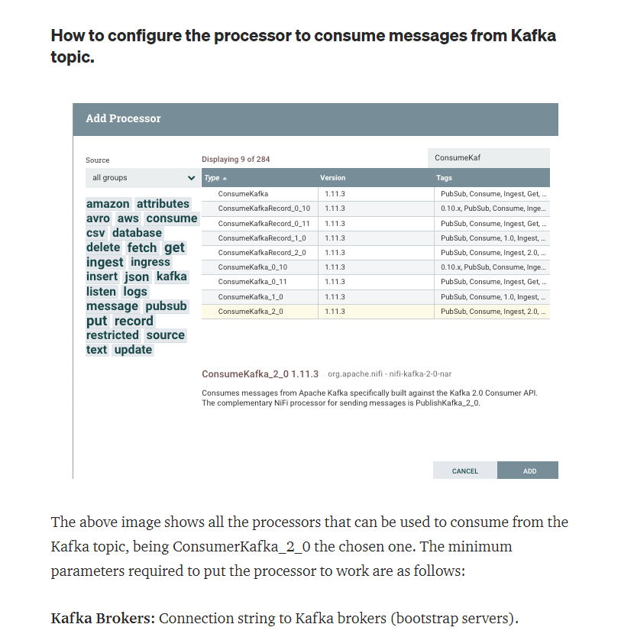
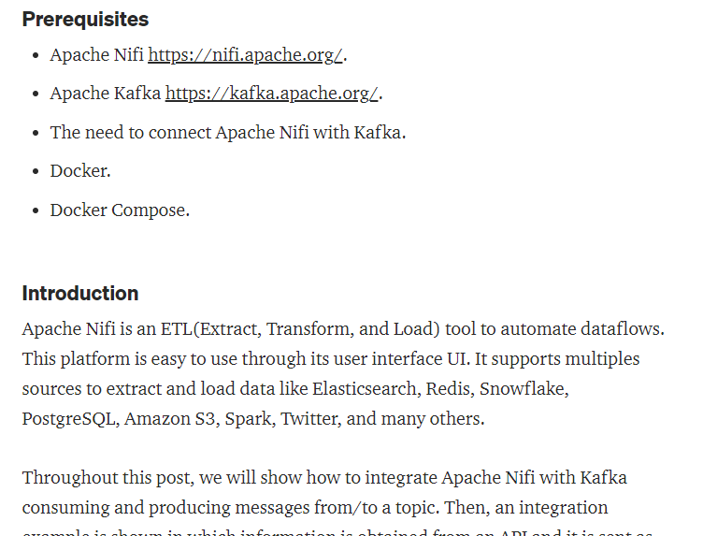

Slide 6
Make a list of what you need.
Build a data stream pipeline
Handle Errors
A way to review failures;
Proper logging
Failed record
A way to check for latency / back pressure

Slide 7
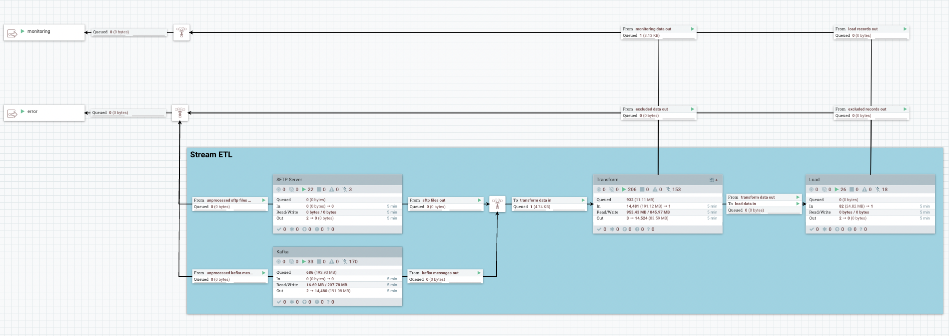
Build a data stream pipeline

Slide 8
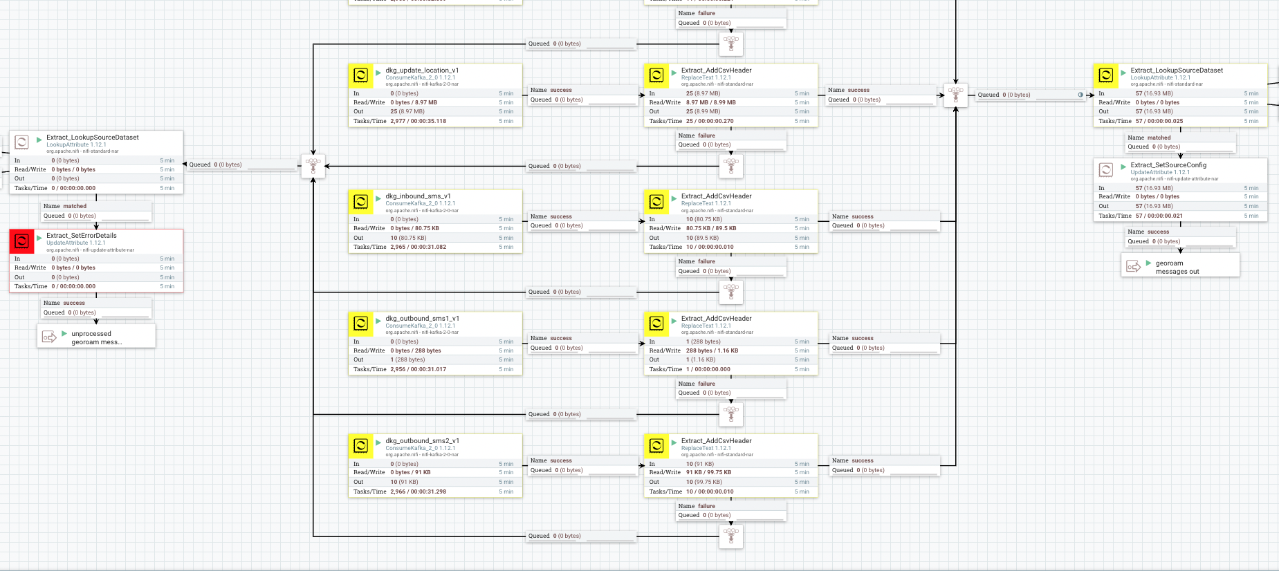
Source

Slide 9
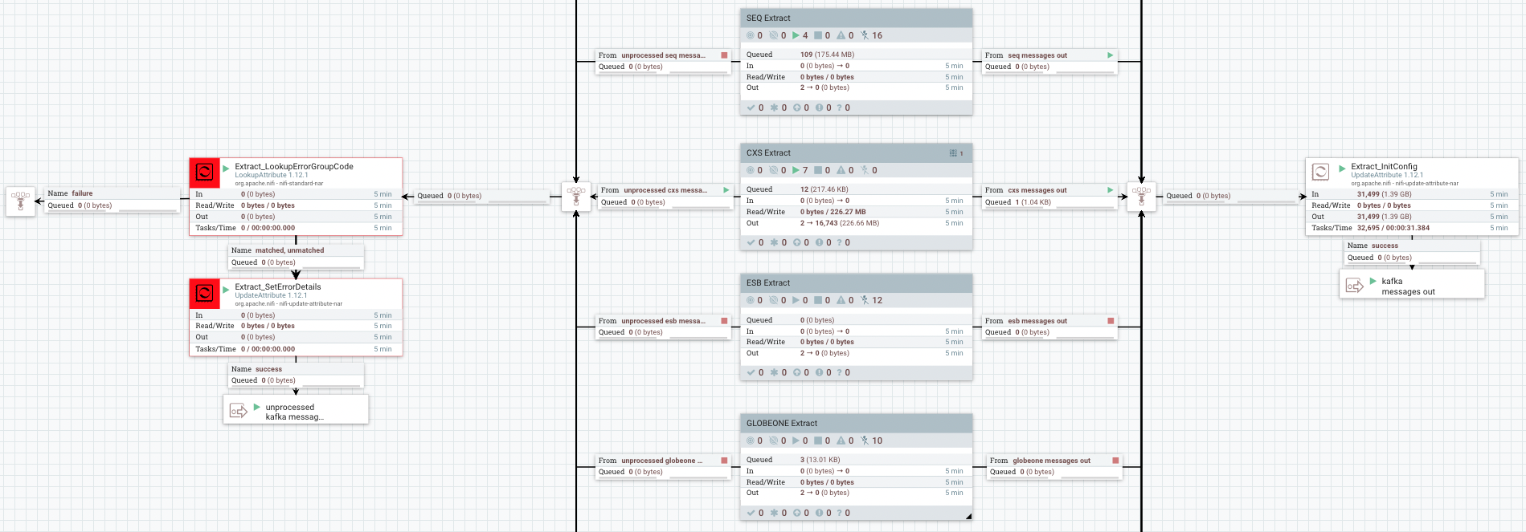
Extract

Slide 10
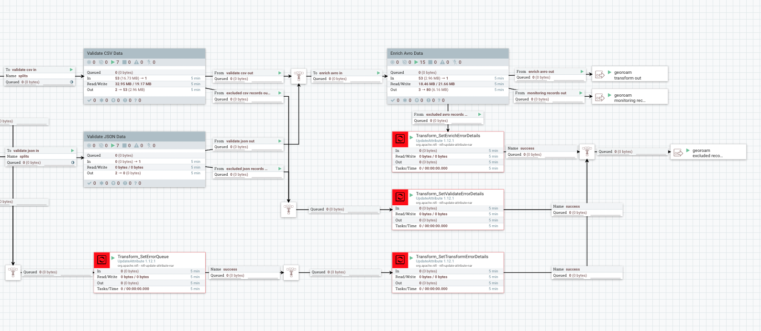
Validate

Slide 11
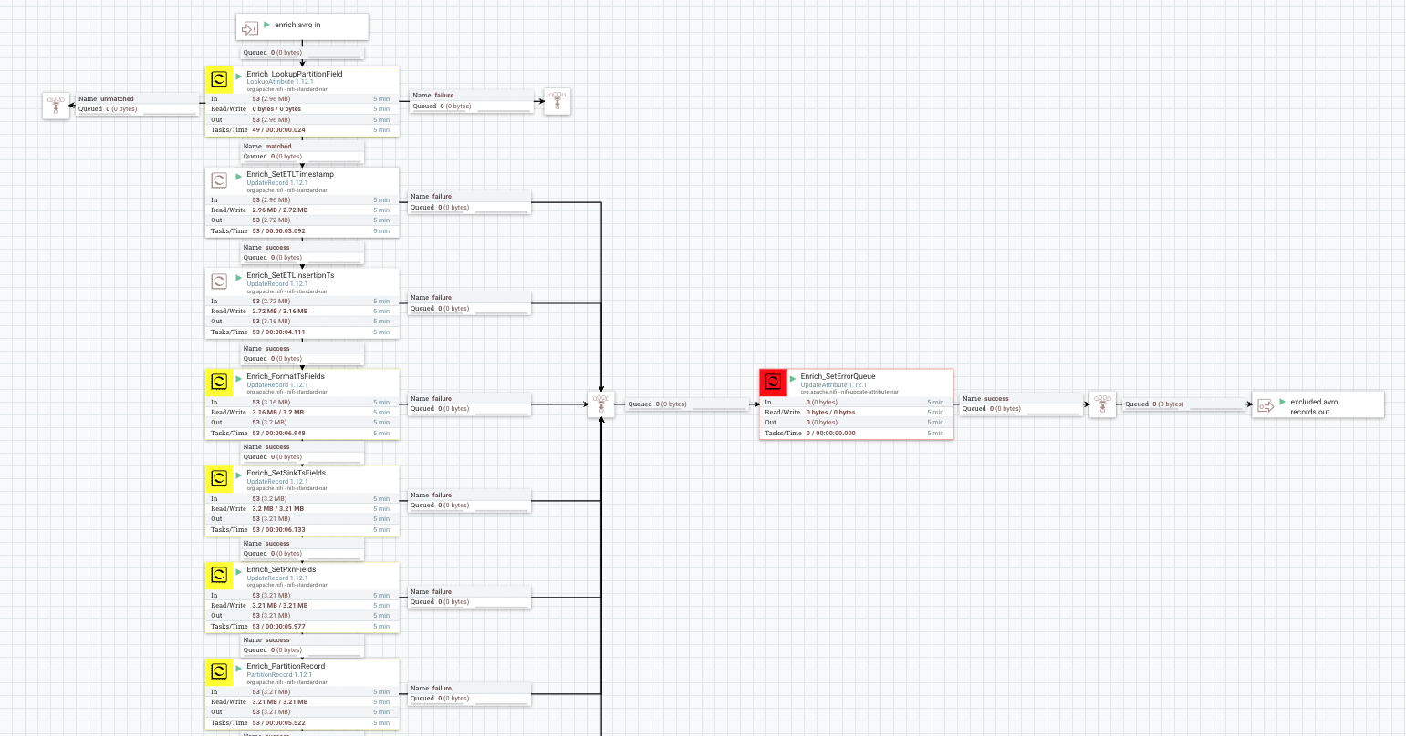
Transform

Slide 12
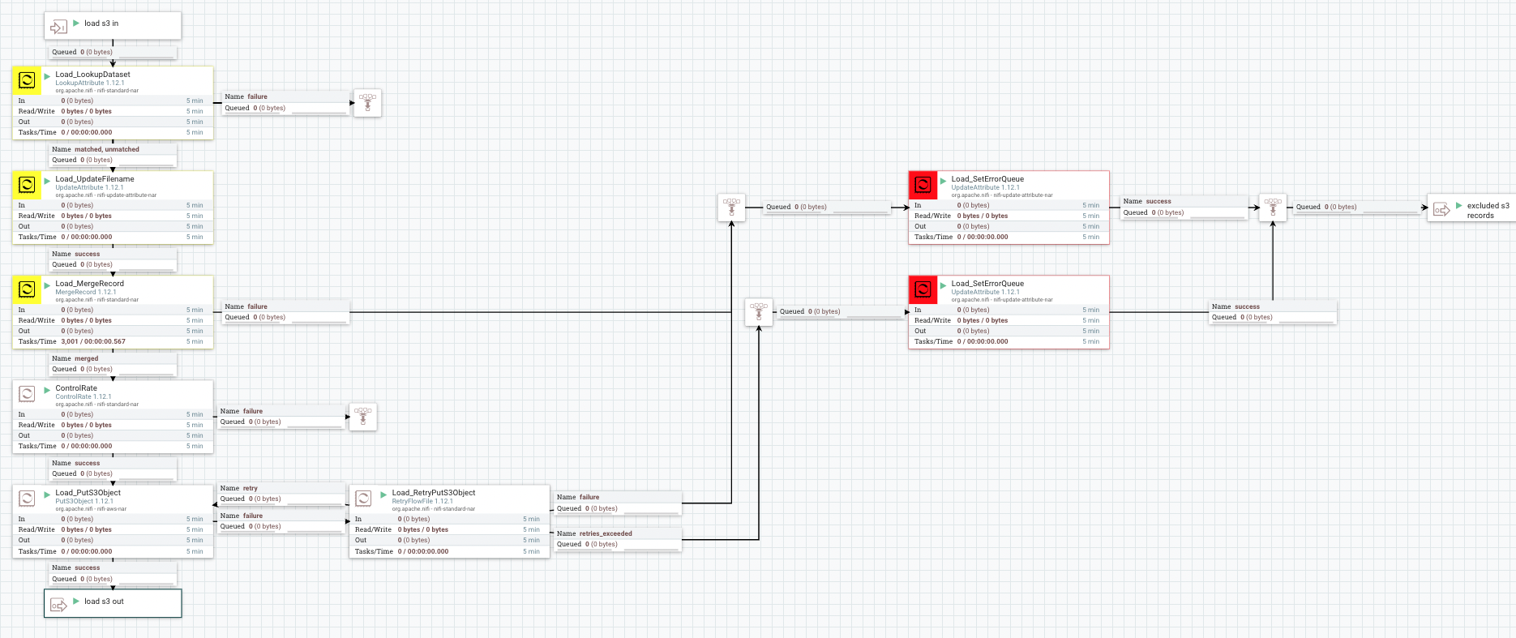
Load

Slide 13
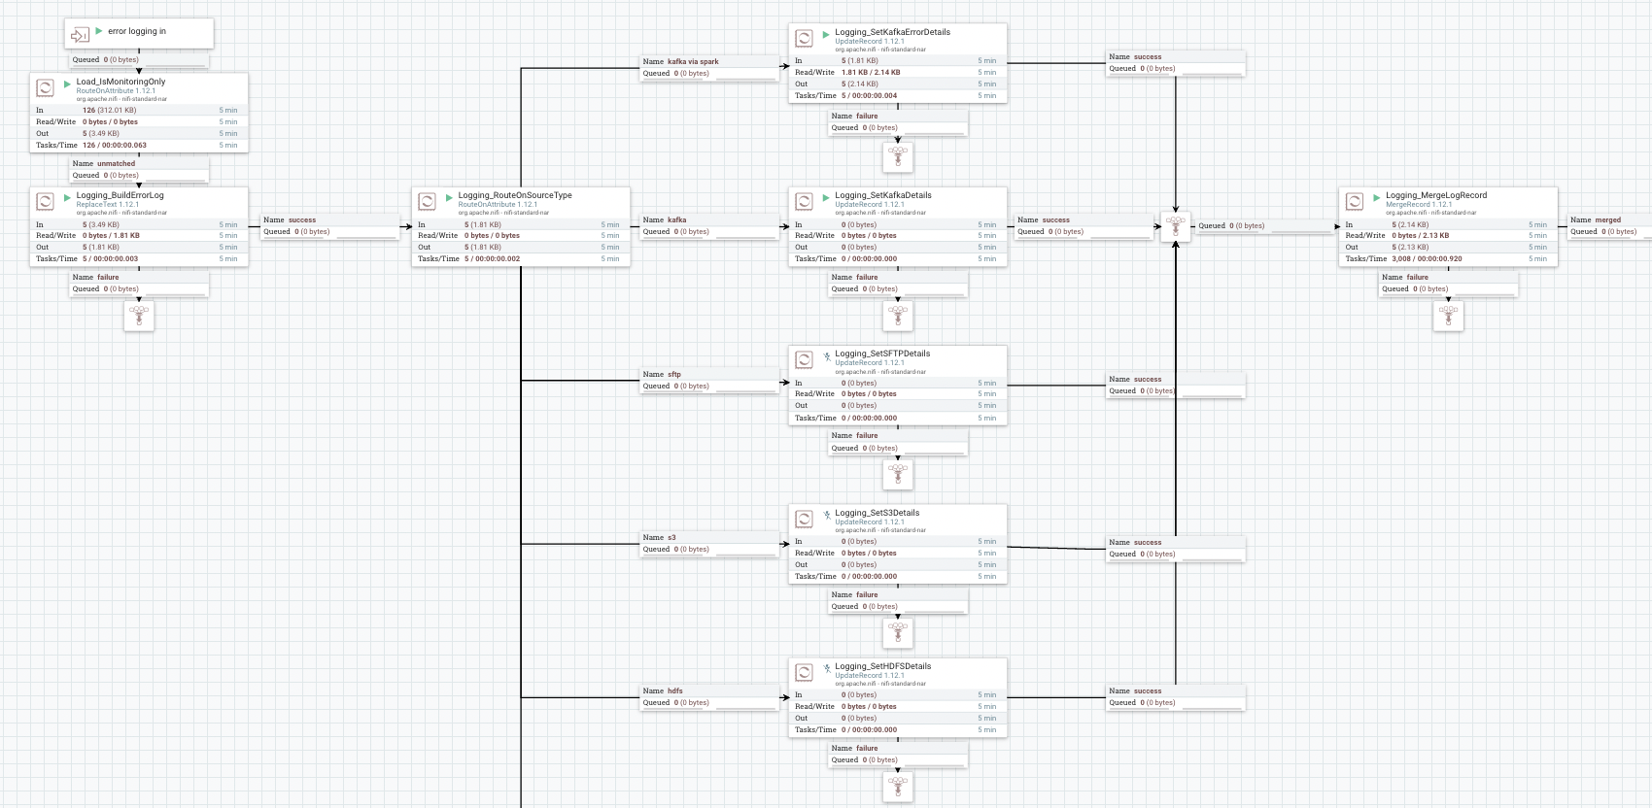
A way to handle errors

Slide 14
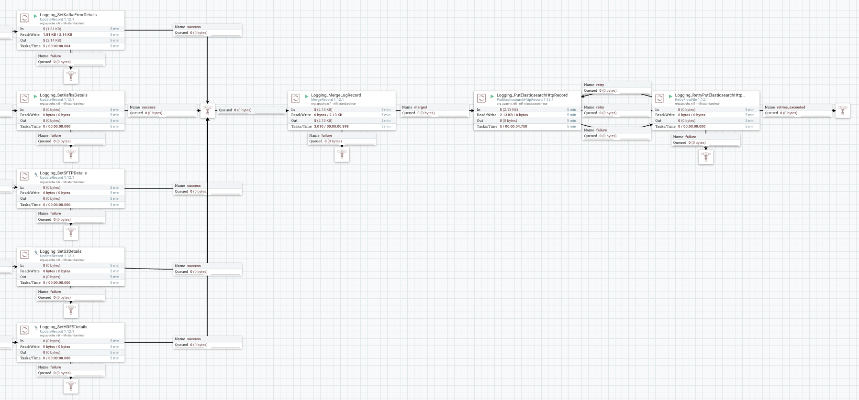
A way to handle errors

Slide 15
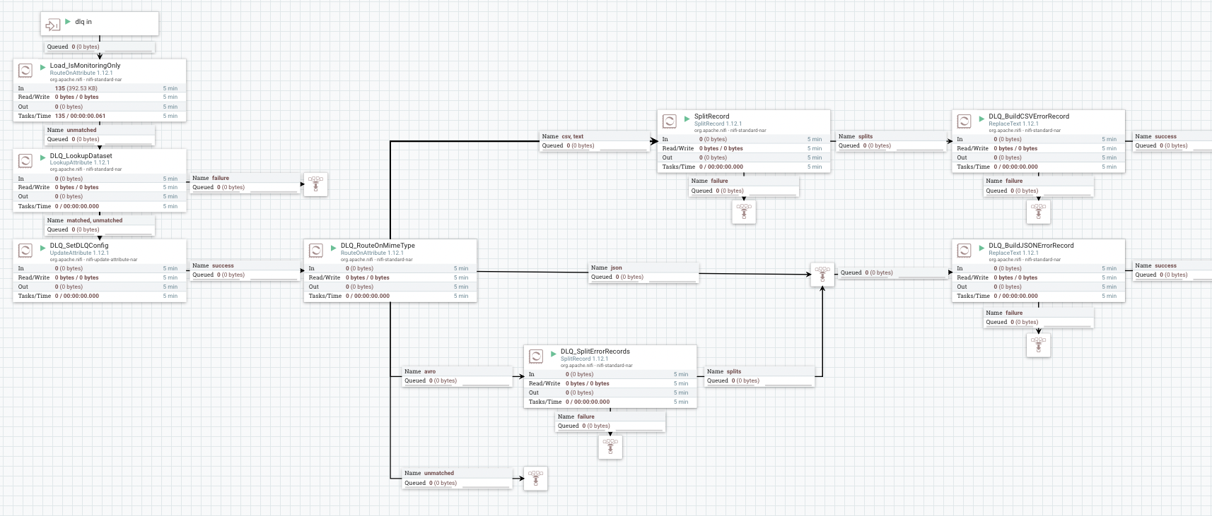
A way to review failures
Notes:
Brief overview of dead letter queue from wikipedia
the dead letter queue is a service implementation to store messages that meet one or more of the following criteria:
Message that is sent to a queue that does not exist.
Queue length limit exceeded.
Message length limit exceeded.
Message is rejected by another queue exchange.
Message reaches a threshold read counter number, because it is not consumed. Sometimes this is called a "back out queue".
The message expires due to per-message TTL
Message is not processed successfully.
Dead letter queue storing of these messages allows developers to look for common patterns and potential software problems.

Slide 16
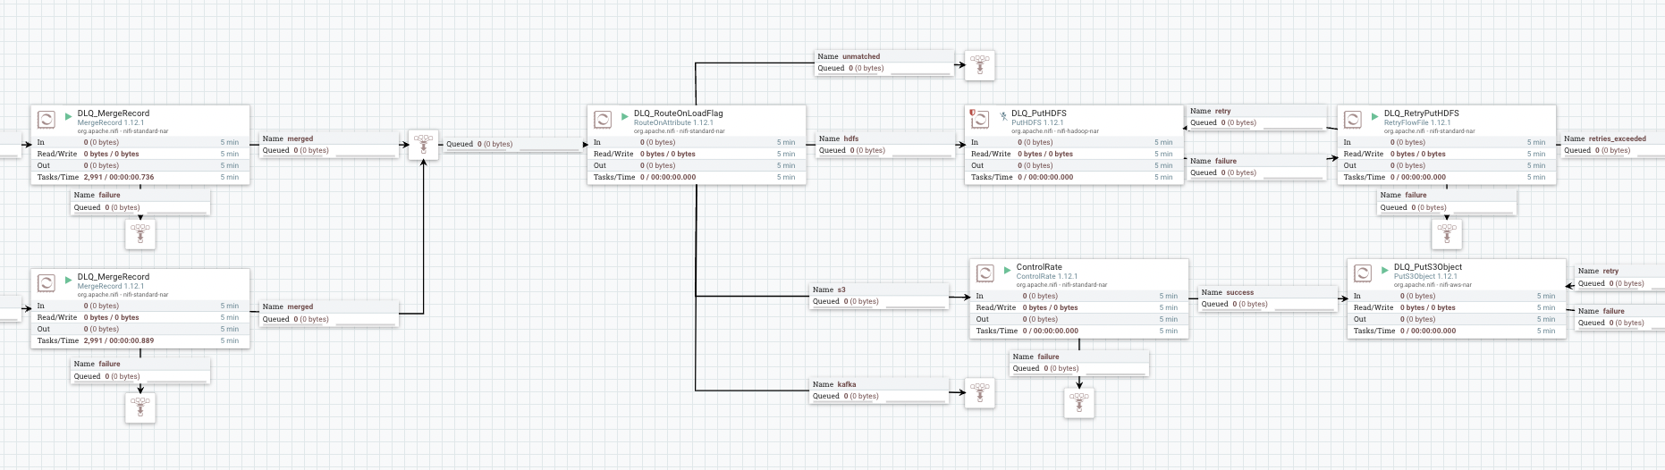
A way to review failures

Slide 17
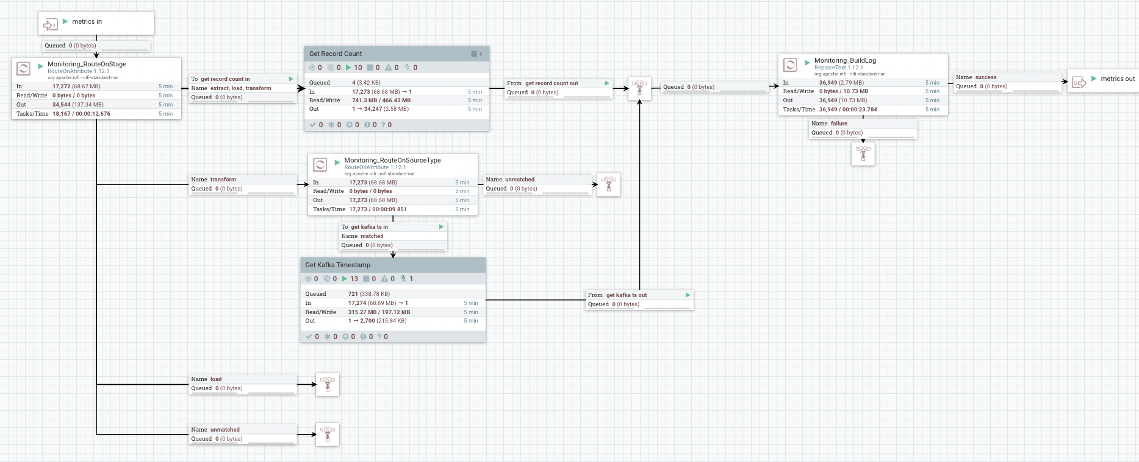
A way to check for latency / back pressure

Slide 18
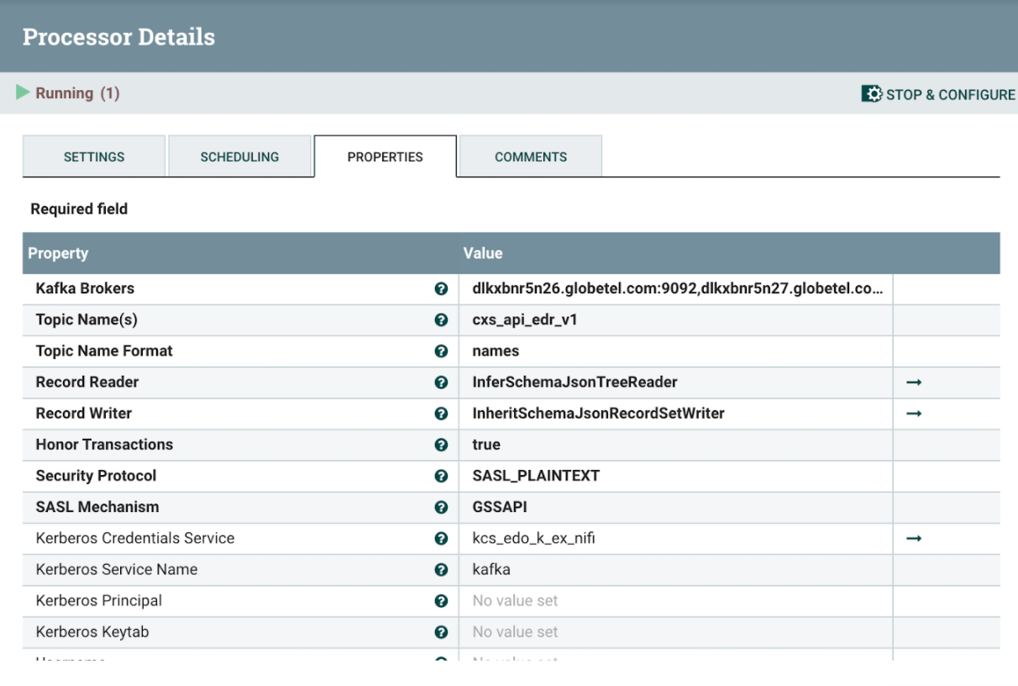
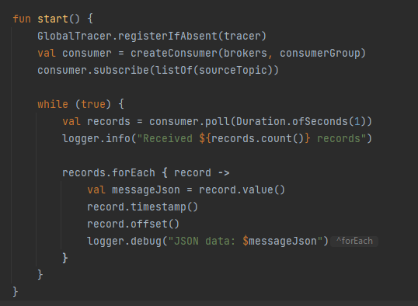
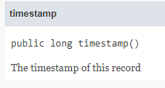
Kafka Timestamp

Slide 20
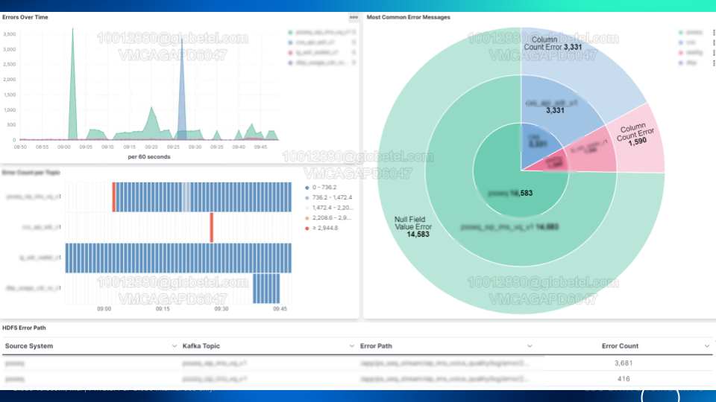

Slide 21
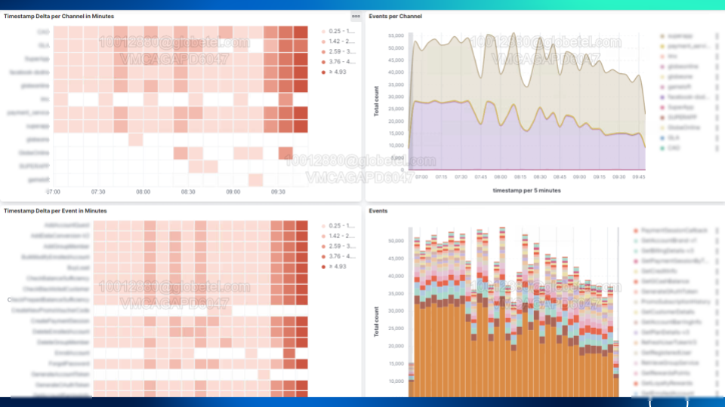

Slide 22
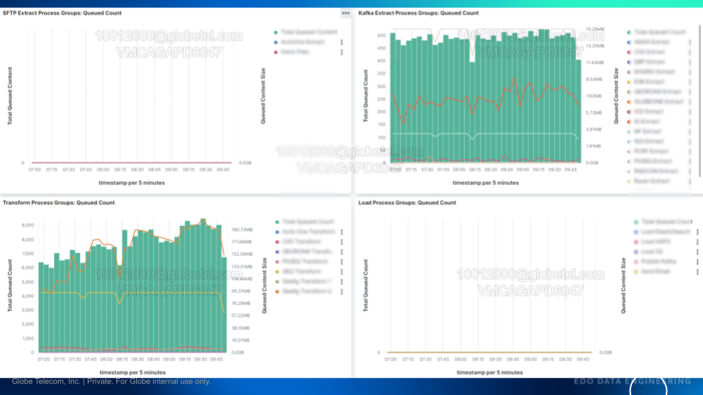

Slide 23
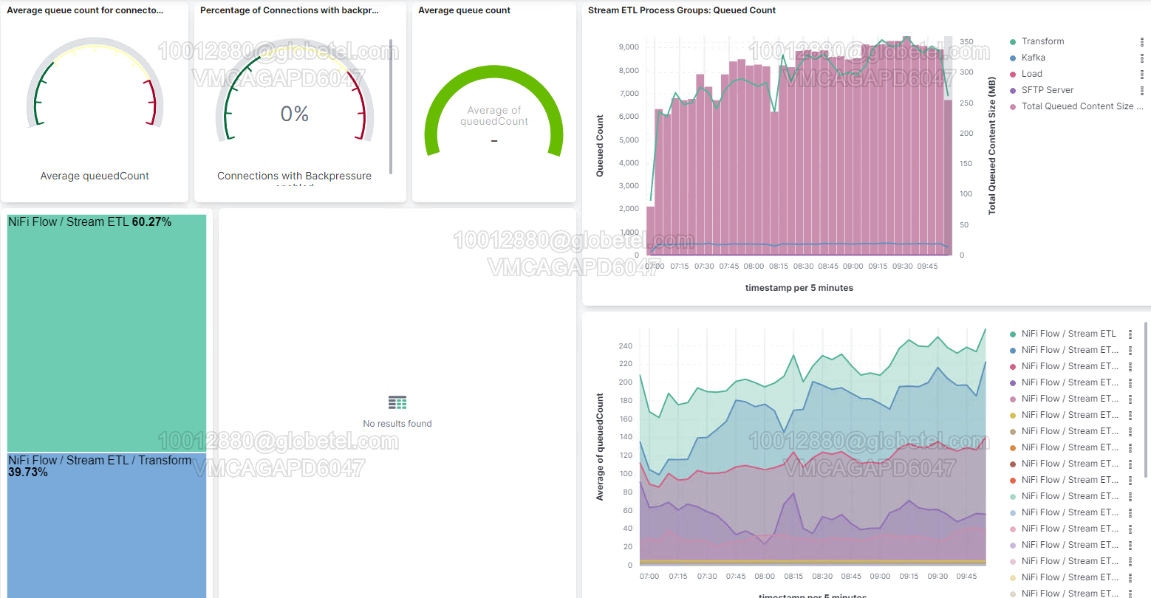

Slide 24
Q&A
Answers to your questions are free during Meetup hours.

